Slide 1
Aushapur(V), Ghatkesar(M) , R.R Dist-50130
DEPARTMENT OF ELECTRONICS AND COMMUNICATION ENGINEERING
MAJOR PROJECT ABSTRACT
COVID-19 DETECTION AND SAFETY MEASURE AUTOMATION USING ARDUINO
Guided By:
Mrs. S. Preethi Assistant Professor
AG1
Cheela Shashank Akkaldevi Hemanth
(17P61A0429) (17P61A0403)
E. Bhanu Prakash Goud (17P61A0442)
K. Sai Prasad (17C21A0411)

Slide 2
ABSTRACT
This pandemic requires utmost safety for each and every person to be safe and healthy. As we analyze the present situation, the count of affected persons is increasing in high rate. Our project will help people to detect Covid-19 affected persons to provide safe entrances and sanitization which is completely contactless and safe. Our prototype consists of Two Arduino Uno boards and RFID kit which are the main components in building a complete project. Temperature sensor, Ultrasonic sensors, Servo motors are been used in our prototype. Our prototype can be used as a “Two level security system” with the help of temperature sensors and buzzers which are integrated to the Arduino. The major part that constructure is the “Robotic Arm” which helps to deliver the goods or products to the customers without any contact. Servo motors and Potentiometers are used to build the robotic arm. We also introduced a “Smart Bin” which stores used tissue papers after dispensing to keep the place neat and clean.

Slide 3
OBJECTIVE
Our main intention is to reduce the spread of this deadly virus and to ensure a safe environment .
To make sure that Covid-19 affected persons with no external help can get things done with proper protection.
To make sure everyone around the place is safe and not in contact with the covid effected person so as to take appropriate measures in case an effected person tries to enter the space.

Slide 4
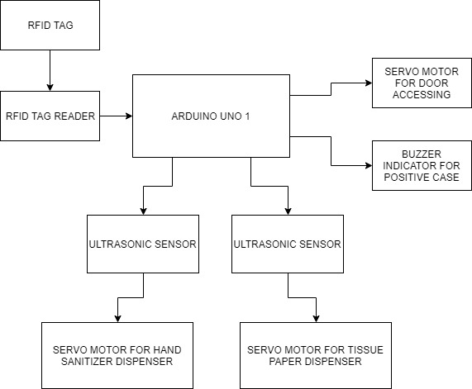
BLOCK DIAGRAM

Slide 5
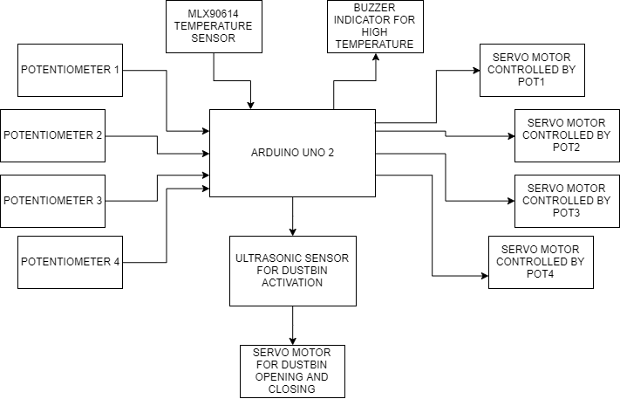
BLOCK DIAGRAM

Slide 6
PLAN OF ACTION
PRC | STATUS
PRC 1 | Based on our idea and realizing the current situation, prepared the abstract and analyzed the details.
PRC 2 | Design of circuit with required components like RFID, Arduino, proximity sensor, servomotors, potentiometers and buzzers. Temperature sensor and liquid disinfectants are also used.
PRC 3 | Design and implementation of Covid-19 Detection and Safety Measure Automation using Arduino is done.

Slide 7
HARDWARE AND SOFTWARE REQUIREMENTS
The simulation is carried out using Proteus 8.9 Professional and Arduino IDE 1.8.13
RC522 RFID Kit, Arduino Uno, Temperature sensor, Buzzers, Potentiometers, Servo motor(SG-90).

Slide 8
ADVANTAGES
Easy detection of Covid affected persons.
Highly compatible and a low cost equipment .
Highly accurate and can be operated without any contact .

Slide 9
APPLICATIONS
Ensures two level security system using RFID and Temperature sensor.
Used to deliver the products to the customers without any contact using the Robotic Arm.
It also helps to sanitize using liquid disinfectants, ultrasonic proximity sensors and servo motors.
The Smart Bin is used to throw away the dispensed tissue papers after use .

Slide 10
REFERENCES
Nath, S., Banerjee, P., Biswas, R. N., Mitra, S. K., & Naskar, M. K. (2016). Arduino based door unlocking system.(https://ieeexplore.ieee.org/document/7917989)
Bakht, K., Din, A. U., Shehzadi, A., & Aftab, M. (2019). Design of an Efficient Authentication and Access Control System Using RFID. 2019 3rd International Conference on Energy Conservation and Efficiency (ICECE).(https://ieeexplore.ieee.org/document/8920871)
Kassim, A. M., Jaafar, H. I., Azam, M. A., Abas, N., & Yasuno, T. (2013). Performances study of distance measurement sensor with different object materials and properties. 2013 IEEE 3rd International Conference on System Engineering and Technology. (https://ieeexplore.ieee.org/document/6650185)
Bhargava, A., & Kumar, A. (2017). Arduino controlled robotic arm. 2017 International Conference of Electronics, Communication and Aerospace Technology (ICECA). (https://ieeexplore.ieee.org/document/8212837)

Slide 11
THANK YOU

